Slide 1
Database management system lab.
CSE 3522
LAB CLASS – 1

Slide 2
Database management
Database
A database is a structured collection of data that is organized, stored, and managed in a way that allows for efficient retrieval, updating, and management of information.
What is Stores
Data organized in tables, rows, and columns (like a digital spreadsheet). Information such as customer details, product inventories, financial records, etc.
Real-world examples:
Your bank's system storing account information
Online shopping sites tracking products and orders
Social media platforms managing user profiles and posts
Hospital systems maintaining patient records
Why databases matter:
Enable quick searching and filtering of large amounts of data
Prevent data loss and corruption
Allow multiple applications to share the same information
Provide security controls for sensitive data
A Database Management System (DBMS) is software that acts as an interface between users/applications and the database itself. It's essentially the "manager" that controls how data is stored, retrieved, and manipulated in a database.

Slide 3
Relational database
The "relational" aspect means you can easily find connections between different pieces of information
A relational database is a type of database that organizes data into tables (called relations) where information is stored in rows and columns, and these tables can be linked together through relationships.
Key Components:
Tables (Relations):
Data is organized in tables, like spreadsheets
Each table represents a specific entity (customers, products, orders)
Tables have a fixed structure with defined columns
Rows (Records/Tuples):
Each row represents a single instance of data
Example: One customer's complete information in a customer table
Relationships:
Tables are connected through common fields
Example: Customer table linked to Orders table through Customer ID
Columns (Fields/Attributes):
Each column represents a specific data type
Example: Name, Email, Phone Number in a customer table
Primary Key:
Unique identifier for each row in a table
Example: Customer ID, Product ID, Order Number
Foreign Key:
A field that links to the primary key of another table
Creates relationships between tables

Slide 4
Relational database
Popular Relational Databases:
MySQL
PostgreSQL
Oracle Database
Microsoft SQL Server
SQLite
Real-world Applications:
Banking systems (accounts, transactions, customers)
E-commerce platforms (products, orders, users)
Hospital management (patients, doctors, appointments)
School systems (students, courses, grades)

Slide 5
Non-Relational database
A non-relational database (also called NoSQL database) is a type of database that doesn't use the traditional table-based structure of relational databases. Instead, it stores data in more flexible formats that can handle various types of data structures.
Key Characteristics:
Flexible Schema: No fixed table structure required
Horizontal Scaling: Can easily distribute data across multiple servers
Various Data Models: Different ways to organize and store data
High Performance: Optimized for specific use cases
Types of Non-Relational Databases:
1. Document Databases:
Store data as documents (usually JSON-like format)
Each document can have different fields
Examples: MongoDB, CouchDB, Amazon DocumentDB
Use Case: Content management, user profiles, product catalogs

Slide 6
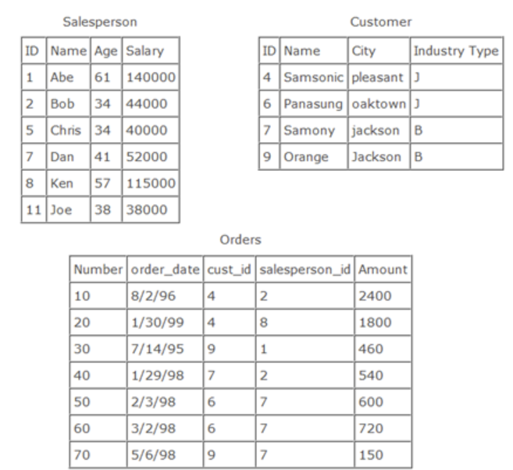
Query language
SQL (Structured Query Language):
Standard language used to interact with relational databases
Commands like SELECT, INSERT, UPDATE, DELETE
Advantages:
Data Integrity: Rules prevent inconsistent data
Reduced Redundancy: Information isn't duplicated unnecessarily
Flexibility: Easy to query and analyze data in multiple ways
Scalability: Can handle large amounts of data efficiently
Standardization: Uses SQL, which is widely known

Slide 7
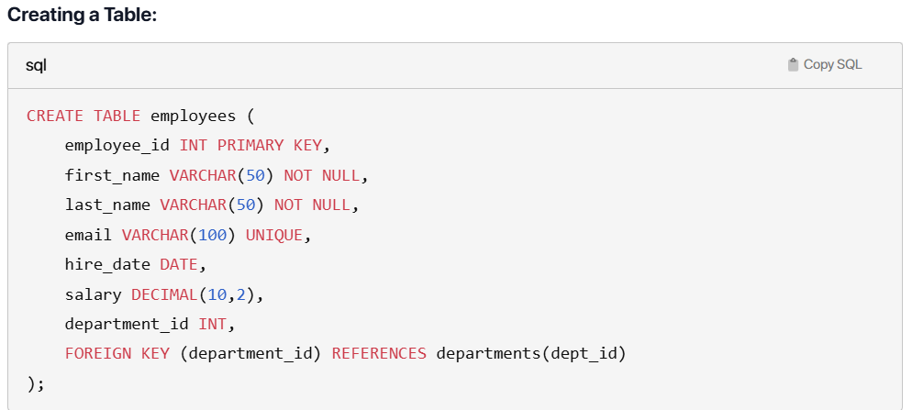
DDL / DML
DDL (Data Definition Language) and DML (Data Manipulation Language) in RDBMS
SQL commands in relational databases are categorized into different types. DDL and DML are two fundamental categories that serve different purposes.
DDL (Data Definition Language)
DDL commands are used to define and modify the database structure. They deal with the schema, tables, indexes, and other database objects.
Key Characteristics:
Auto-commit: Changes are automatically saved
Structure-focused: Deals with database schema
Administrative: Usually performed by database administrators
Permanent changes: Affects the database structure permanently
Main DDL Commands:
1. CREATE
Creates new database objects (tables, indexes, views, etc.)
2. ALTER
Modifies existing database objects

Slide 8
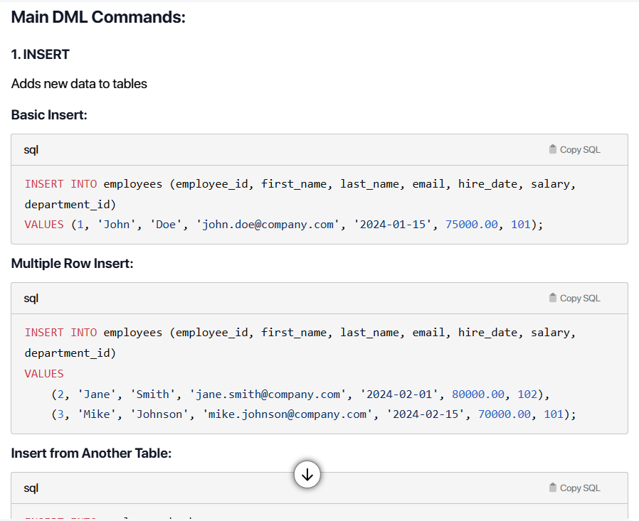
DDL / DML
DML (Data Manipulation Language)
DML commands are used to manipulate data within existing database structures. They deal with inserting, updating, deleting, and retrieving data.
Key Characteristics:
Transaction-based: Can be rolled back
Data-focused: Deals with actual data content
User-oriented: Commonly used by application users
Conditional changes: Can be undone before commit

Slide 9
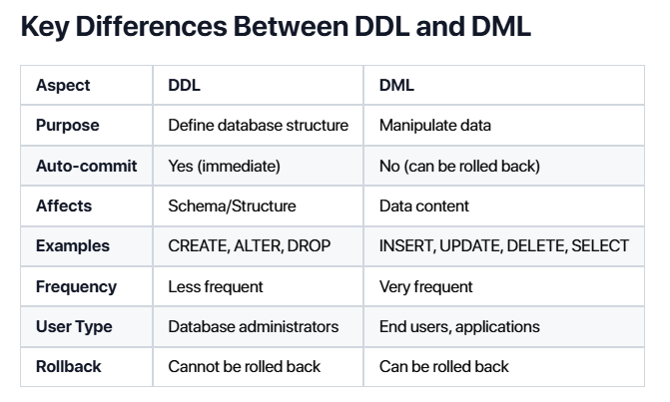
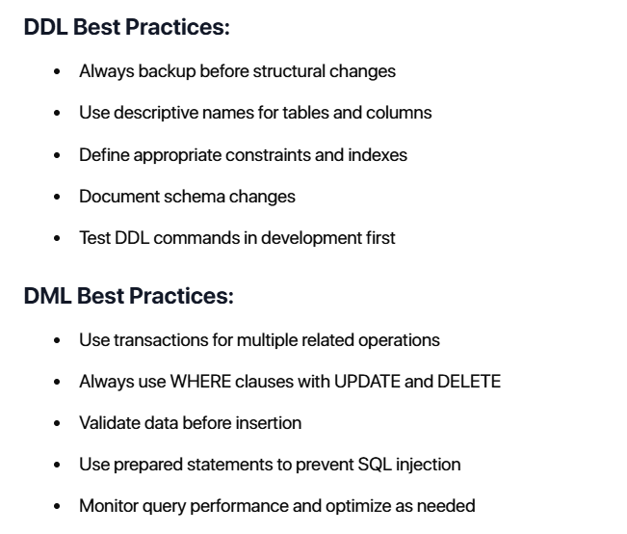
DDL / DML

